Slide 1
Observations, Concepts and Encounters
A programmer's guide

Slide 2
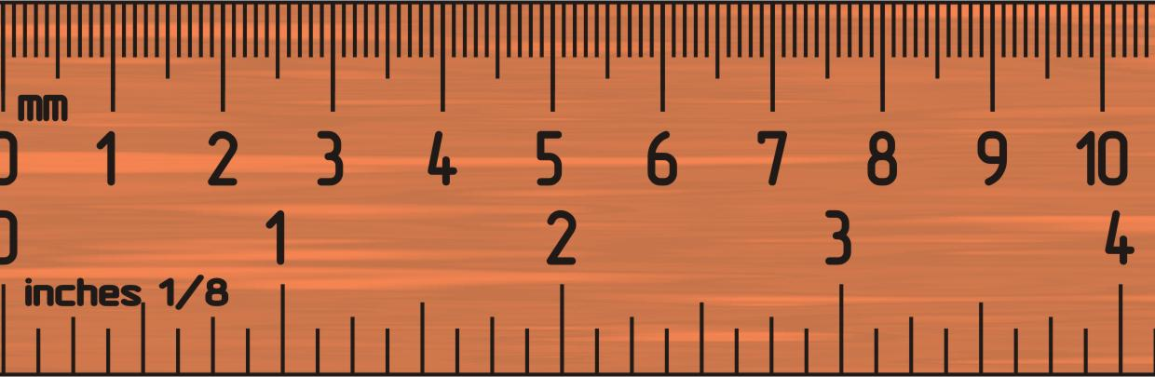
What's an obs?
Obs is short for observation
It can be measurement or a question, e.g.
What is a person's HIV status?
Are they pregnant?
What is their height?
What is their weight?

Slide 3
The flat table approach
Many EMR's start as spreadsheets, using a flat table to hold observations of patients, e.g.
Patient | Height | Weight | Pregnant | HIV
Ben | 160 | 70 | No | No
Rita | 150 | 60 | No | No
Rowan | 170 | 80 | No | No
Christian | 160 | 75 | No | No
Observations
Patients

Slide 4

Flat table problems
Table gets unmanageably big as we keep adding new observations
Gets really complicated when we want multiple records of the same observation type, e.g. weight change over time
Wasted space when columns aren't used

Slide 5
Adding time
Adding time information to the observations means we can record change over time without creating new columns, e.g.
OBSERVATIONS
PATIENTS
Patient | Date | Height | Weight | Pregnant | HIV
1 | 23/9/10 | 160 | 70 | No | No
2 | 23/9/10 | 150 | 60 | No | No
3 | 23/9/10 | 170 | 80 | No | No
4 | 23/9/10 | 160 | 75 | No | No
1 | 30/9/10 | 160 | 100 | No | No
2 | 30/9/10 | 140 | 60 | No | No
Patient | Name
1 | Ben
2 | Rita
3 | Rowan
4 | Christian

Slide 6
Adding concepts
Each observation becomes a concept and a value… like a question and an answer
PATIENTS
CONCEPTS
Patient | Name
1 | Ben
2 | Rita
3 | Rowan
4 | Christian
Concept | Question
1 | Height
2 | Weight
2 | HIV Status
3 | Pregnant
OBSERVATIONS
Patient | Date | Concept | Value
1 | 23/9/10 | 1 | 160
2 | 23/9/10 | 1 | 150
3 | 23/9/10 | 2 | 80
4 | 23/9/10 | 2 | 75
1 | 30/9/10 | 3 | No
2 | 30/9/10 | 3 | No

Slide 7
Concept IDs
If different EMRs are going to share data, then there needs to be a way of standardizing concepts
Is the concept called "HEIGHT" in one EMR the same as the concept called "HEIGHT" in another?
We use an ID value which can be made standard across different EMRs…
Concept | ConceptId | Question
1 | 5090 | Height
2 | 1001 | Weight
2 | 2050 | HIV Status
3 | 4000 | Pregnant
Internal database id
External standardized id

Slide 8
Concepts in code
OpenMRS defines a Concept class
To get a specific concept use the ConceptService, e.g.
Concept height = Context.getConceptService().getConcept(5090);
Concept id for height

Slide 9
Concept management
It's important to keep concepts standardized across different OpenMRS installations
Means we can compare data from different installations
Concepts should be managed, e.g.
Partners In Health maintains a concept dictionary in Boston to keep all their sites using the same concepts
If you need a new concept - ASK FIRST

Slide 10
Concept standards
There are several existing standards for medical concepts, used by other EMR systems, e.g.
SNOMED (Systematized Nomenclature of Medicine -- Clinical Terms). You can browse its concepts at http://terminology.vetmed.vt.edu/SCT/menu.cfm
ICD-10 (International Classification of Diseases - Revision 10)

Slide 11
Concept mapping
OpenMRS concepts can be mapped to concepts defined by standards such as SNOMED, e.g.
OpenMRS dictionary
SNOMED
Weight (5089)
Normal height (309534003)
Height (5090)
Normal weight (43664005)
…
…

Slide 12

Creating observations
For a single observation we want to store the following:
Patient
Concept
Value
Time/date
Location
?
=

Slide 13
Obs values
Different concepts will require different types of answers, e.g.
"Height" and "weight" concepts will require a numeric value
"Pregnant" concept might require "Yes" or "No" answers (coded values)
"Comment" (i.e. from doctor) needs to be stored as text
How can one field store all of these?

Slide 14
Obs
Look inside the Obs class and you'll see all these fields…
protected Concept valueCoded;
protected ConceptName valueCodedName;
protected Drug valueDrug;
protected Integer valueGroupId;
protected Date valueDatetime;
protected Double valueNumeric;
protected String valueModifier;
protected String valueText;
protected String valueComplex;
Each of these has a getter and setter

Slide 15
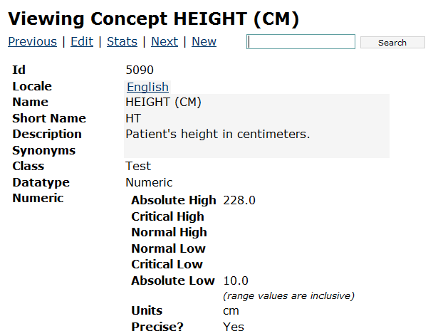
Example: numeric
Concept name is very specific and includes units
Concept id
Numeric value types

Slide 16
Example: numeric
To create a height observation, create an instance of Obs and set its properties…
Existing patient and location objects
Obs obs = new Obs();
obs.setPerson(patient);
obs.setLocation(location);
obs.setObsDatetime(new Date());
obs.setConcept(conceptService.getConcept(5090));
obs.setValueNumeric(150);
Sets the value as a number
Gets the concept for HEIGHT by its concept ID

Slide 17
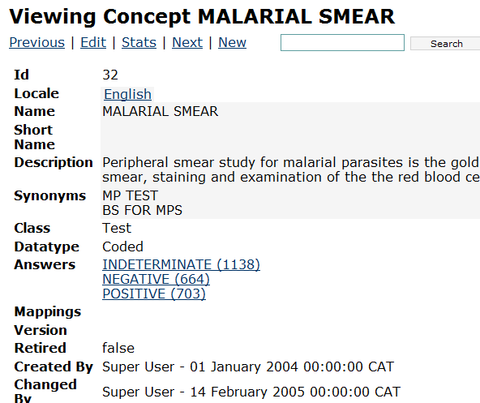
Example: coded
Coded data type
Possible answers are other concepts

Slide 18
Example: coded
To create a observation of a coded concept, we need to set the value as another concept
Obs obs = new Obs();
obs.setPerson(patient);
obs.setLocation(location);
obs.setObsDatetime(new Date());
obs.setConcept(conceptService.getConcept(32));
obs.setValueCoded(conceptService.getConcept(664));
Gets the concept for MALARIA SMEAR by its concept ID
Gets the concept for NEGATIVE

Slide 19
Convenience sets
Some concepts will often be used together,
E.g. when a patient visits the a doctor they often record "vital signs" such as height, weight, blood pressure, temperature
For convenience these can be grouped into a set of concepts, called a ConvSet
Vital signs
Height
Temperature
Weight
Respiratory Rate
Head Circumference

Slide 20
Observing convenience sets
To create an observation of a ConvSet we need to create an observation grouping
We add observations for each concept to the grouping as members…
Grouping obs
Obs
Obs
Obs
Obs
Obs

Slide 21
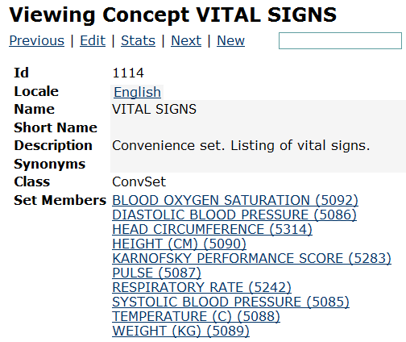
Example: ConvSet
ConvSet class
Members

Slide 22
Example: ConvSet
We first create an obs to be the grouping obs, and then we add the other obs to that, e.g.
Concept id for vital signs
Obs groupingObs = new Obs();
Obs valueObs = new Obs();
groupingObs.setConcept(conceptService.getConcept(1114)));
groupingObs.setObsDatetime(observationDate);
groupingObs.setPerson(patient);
groupingObs.setLocation(location);
valueObs.setPerson(patient);
valueObs.setLocation(location);
valueObs.setObsDatetime(observationDate);
valueObs.setConcept(conceptService.getConcept(5090));
valueObs.setValueNumeric(23);
groupingObs.addGroupMember(valueObs);
Concept id for height
Height obs added as member

Slide 23
Obs service examples
To create a new obs, use saveObs...
To get all the obs for a specific person and concept, use...
Obs obs = new Obs();
obs.setLocation(...);
...
Context.getObsService().saveObs(obs);
Patient patient = ...
Concept concept = Context.getConceptService().getConcept(5090);
List<Obs> obs = Context.getObsService().
getObservationsByPersonAndConcept(patient, concept);

Slide 24
Encounters
Observations typically come from an event such as:
The patient visits a clinician
A form is submitted which records observations
An event such as this is called an Encounter
It describes a formal interaction between a provider and a patient
Encounters can have many observations

Slide 25

Encounters
Thus for a single encounter we want to store the following:
Patient
Provider
Time/date
Location
Observations

Slide 26
Encounters
Encounters are created like observations, with a location, date, and patient
We must also specify a provider, and add some observations
Encounter encounter = new Encounter();
encounter.setEncounterDatetime(date);
encounter.setLocation(location);
encounter.setPatient(patient);
encounter.setProvider(provider);
encounter.addObs(obs1);
encounter.addObs(obs2);

Slide 27
Encounter service examples
To create a new encounter, use...
To get all the encounters for a specific patient, use...
Encounter encounter = new Encounter();
...
Context.getEncounterService().saveEncounter(encounter);
Patient patient = ...
List<Encounter> encounters = Context.getEncounterService().
getEncountersByPatient(patient);

Slide 28
References
http://wiki.openmrs.org/display/archive/Concept+Dictionary+Guidelines

